Slide 1
Introduction to Deep Learning: Algorithms and Their Applications
CDC Short Course
Xiaoming Huo, Georgia Tech

Slide 2
Schedule
8:30-9:30 Lecture 1: Introduction
9:45-10:45 Lecture 2: Course Materials and Resources
11:00-12:00 Lecture 3: Perceptron
12:00-1:15 Lunch break
1:15-2:00 Lecture 4: Neural Network, Software
2:15-3:00 Lecture 5: Convolution Networks
3:15-4:00 Lecture 6: Some Examples
4:00 Adjourn

Slide 3
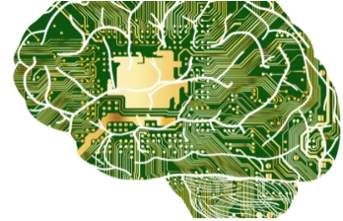
hardware
more...
package
Hardware for Deep Learning
(articleshub360.com)

Slide 4
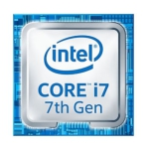
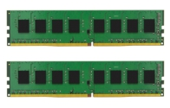
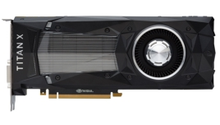
hardware
more...
package
Your GPU Computer
Intel i7
0.15 TFLOPS
DDR4
32 GB
Nvidia Titan X
12 TFLOPS
16 GB

Slide 5
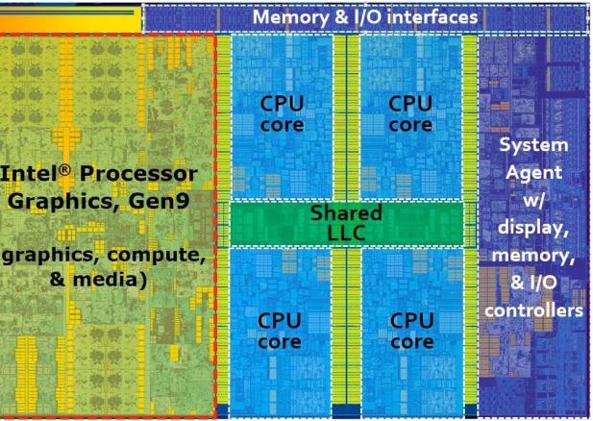
hardware
more...
package
Intel i7-6700K
• 4 Physical cores
• Per core
• 64KB L1 cache
• 256KB L2 cache
• Shared 8MB L3 cache
• 30 GB/s to main
memory

Slide 6
hardware
more...
package
Improve CPU Utilization I
• Before computing a + b, need to prepare data first
• Main memory -> L3 -> L2 -> L1 -> registers
• L1 cache reference time: 0.5 ns
• L2 cache reference time 7 ns (14 x L1)
• Main memory reference time 100ns (200 x L1)
• Improve temporal and spatial memory locality
• Temporal: reuse data so we keep them on cache
• Spatial: read data sequential so we can pre-fetch data

Slide 7

hardware
more...
package
Case Study
• For a matrix stored in raw-major, accessing a column is
slower than accessing a row
• CPU reads 64 bytes (cache line) each time
• CPU “smartly” reads the next cache line ahead when
it’s needed

Slide 8
hardware
more...
package
Improve CPU Utilization II
• Server CPUs may have dozens of cores
• EC2 P3.16xlarge: 2 Intel Xeon CPUs, 32 physical
cores in total
• Parallelization to use all cores
• Hyper-threading may not help because of shared
registers

Slide 9
hardware
more...
package
Case Study
• Left is slower than right (Python)
for i in range(len(a)):
c[i] = a[i] + b[i]
c = a + b
• Left issues n calls, each invoking has certain
overhead (e.g. several microsecond)
• Right is easier to be parallelized by a C++ operator
#pragma omp for
for (i=0; i<a.size(); i++) {
c[i] = a[i] + b[i]
}

Slide 10
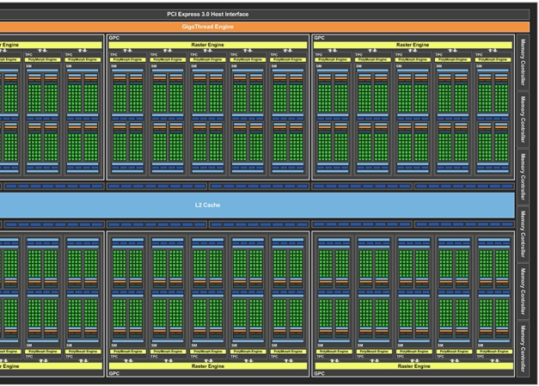
hardware
more...
package
Nvidia Titan X (Pascal)
• 2584 cores, each core
• Multiple arithmetic
units
• 3MB L2 cache
• 480 GB/s memory
bandwidth

Slide 11
hardware
more...
package
Improve GPU Utilization
• Parallelization
• Uses thousands of threads
• Memory locality
• Simple cache architecture and small cache size
• Simple control flows
• Very limited support
• Large synchronization

Slide 12
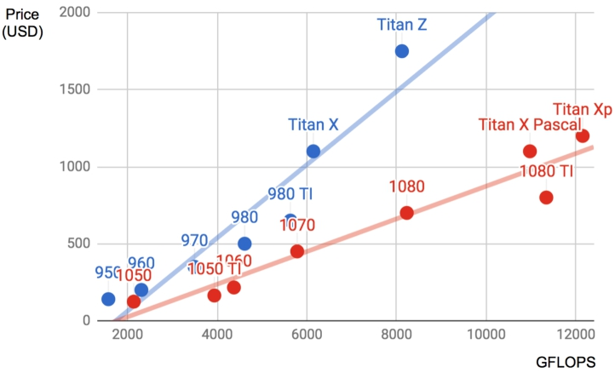
hardware
more...
package
Buy GPUs
• Each series improve
the previous one
• Buy new models
• Price is linear to
power in a series

Slide 13

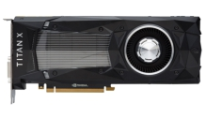

hardware
more...
package
CPU vs GPU
# Cores
6 / 64
2K / 4K
TFLOPS 0.2 / 1 10 / 100
Memory size 32 GB / 1 TB 16 GB / 32 GB
Memory
bandwidth
30 GB/s / 100 GB/s 400 GB/s / 1 TB/s
Control flow Strong Weak
Typical / High End

Slide 14
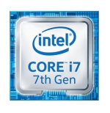
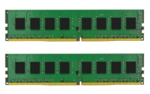
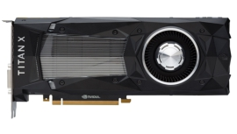
hardware
more...
package
CPU/GPU Bandwidth
30 GB/s
PCIe 3.0 16x: 16 GB/s
480 GB/s
• Do not copy data between GPU and CPU frequently
• Limited PCIe
bandwidth
• Synchronization
overhead
PCIe: Peripheral Component Interconnect Express

Slide 15
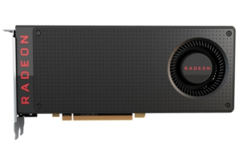
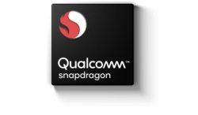
hardware
more...
package
More CPUs and GPUs
• CPU
• Desktop/Server: AMD
• Edge: ARM
• GPU
• Desktop/Server GPU: AMD, Intel
• Edge: ARM, Qualcomm

Slide 16
hardware
more...
package
Programming on CPU/GPU
• CPU: C++ or any other high-performance language
• Mature compilers with performance guaranteed
• GPU
• CUDA for Nvidia
• Rich features, mature complier and driver
• OpenCL for others
• Quality varies for chip vendors

Slide 17
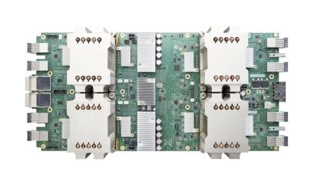
hardware
more...
package
More Promising Hardware

Slide 18
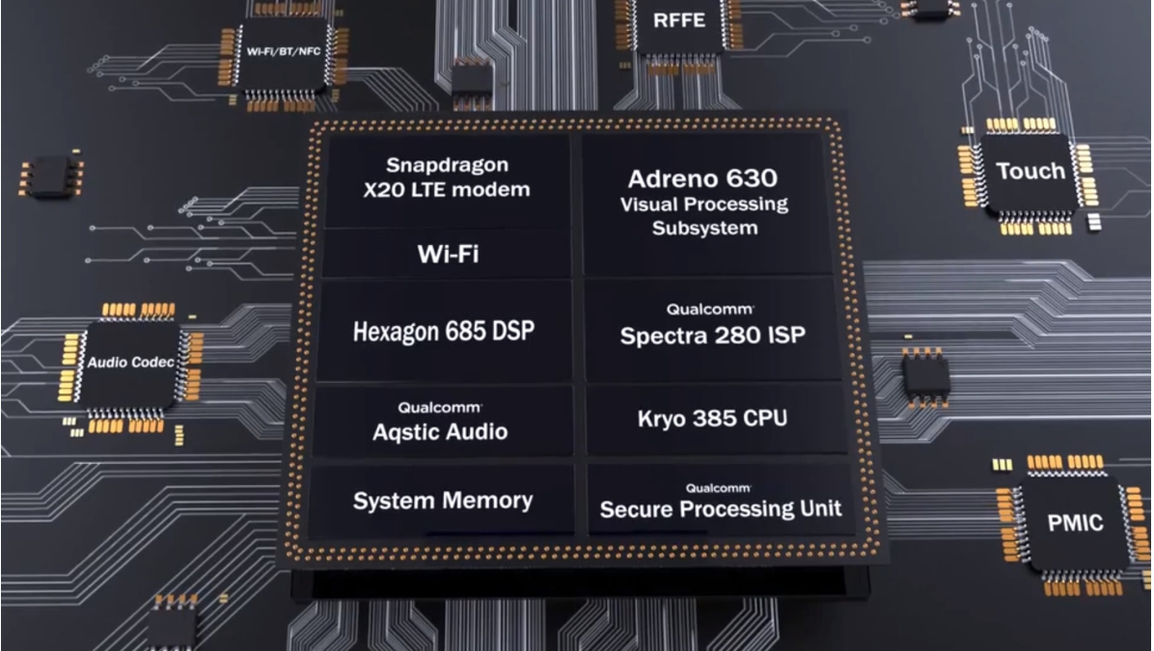
hardware
more...
package
Qualcomm Snapdragon 845

Slide 19
hardware
more...
package
Digital Signal Processor
• Designed for digital processing algorithms
• Dot product, Convolution, FFT
• Low power and high performance
• 5x faster than mobile GPUs, uses less power
• VLIW: Very long instruction word
• Hundreds multiply-accumulates in a single instruction
• Hard to program and debug
• Compiler toolchain quality varies from chip vendors

Slide 20
hardware
more...
package
Field-Programmable Gate Array (FPGA)
• Contains a large number of programmable logic blocks
and reconfigurable interconnects
• Can be configured to perform complex functions
• Common languages: VHDL and Verilog
• Often has high efficiency than general purpose hardware
• Toolchain qualities vary
• Each “compilation” may take several hours

Slide 21
hardware
more...
package
AI ASIC
• Hot topic in deep learning
• Every major company is building their chips (Intel,
Qualcomm, Google, Amazon, Facebook, …)
• Google TPU is a landmark chip
• Matches high-end Nvidia GPU’s performance, but
10x-100x cheaper
• Widely deployed in Google
• The core is a systolic array

Slide 22
hardware
more...
package
Systolic Array
• An array of processing elements (PE)
• Good at performing matrix-matrix multiplication
• Relative easy/cheaper to build
PE PE PE
PE PE PE
PE PE PE
Input
Output

Slide 23
hardware
more...
package
Matrix Multiplication with Systolic Array
Time 0 Y = WX
x12 x11 w11 w21 w31 3x2 3x3 3x2
x22
x31
x21
0
0
0
w12
w13
w22
w23
w32
w33
x32

Slide 24

hardware
more...
package
Matrix Multiplication with Systolic Array
Time 1 Y = WX
x12 x11w11 w21 w31 3x2 3x3 3x2
Move inputs to right
x32
w12
w13
w22
w23
w32
w33
x22
x31
x21
0

Slide 25

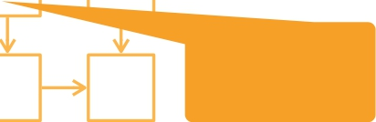
hardware
more...
package
Matrix Multiplication with Systolic Array
Time 2
Move results
Y = WX
3x2 3x3 3x2
x12w11
x11w21
w31
to bottom
x32
Move inputs to right
x22
x31
x11w11+ x21w12
w13
w22
w23
w32
w33

Slide 26


hardware
more...
package
Matrix Multiplication with Systolic Array
Time 3 Y = WX
x12w21
x21w22+ x11w21
x11w31
w32
3x2 3x3 3x2
Move inputs
to right
x22w12+ x12w11
x31w13+
x32
x21w12+ x11w11
w23
w33
Move results
to bottom

Slide 27
hardware
more...
package
Matrix Multiplication with Systolic Array
Time 4 Y = WX
x12w31 3x2 3x3 3x2
x22w22+ x12w21
x21w22+ x11w31
x32w13+ x22w12+ x12w11
y11
x31w23+ x21w22+ x11w21
w33

Slide 28
hardware
more...
package
Matrix Multiplication with Systolic Array
Time 5
Y = WX
3x2 3x3 3x2
x22w22+ x12w31
x31w23+ x21w22+ x11w21
x32w23+ x22w22+ x12w21
y12 y11
y21

Slide 29
hardware
more...
package
Matrix Multiplication with Systolic Array
Time 6
Y = WX
3x2 3x3 3x2
x33w23+ x23w22+ x13w21
y22 y22
y12
y11
y21

Slide 30
hardware
more...
package
Matrix Multiplication with Systolic Array
Time 7
Y = WX
3x2 3x3 3x2
y32
y22 y31
y12 y21

Slide 31
hardware
more...
package
Systolic Array
• For general size matrix multiplication, slice and pad inputs
to match the SA size
• Batch inputs to reduce the latency cost
• ASIC has other dedicated components for other NN
operations, such as sigmoid

Slide 32
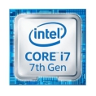


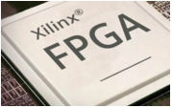
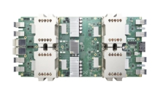
hardware
more...
package
Flexibility and Ease of Use
Performance & Power Efficiency

Slide 33
hardware
more...
package
Packages

Slide 34





hardware
more...
package
mxnet
before 2012 2013 2014 2015 2016 2017

Slide 35
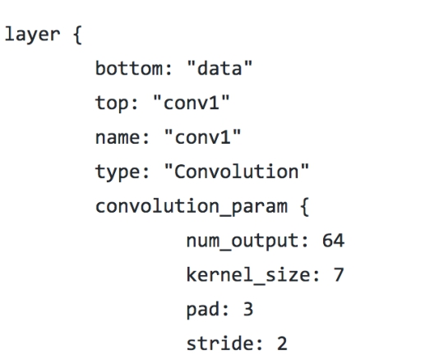
hardware
more...
package
Caffe
ResNet-101-deploy.prototext
• Protobuf as the interface
• Good CV model coverage
• Portable
• Not flexible to develop

Slide 36
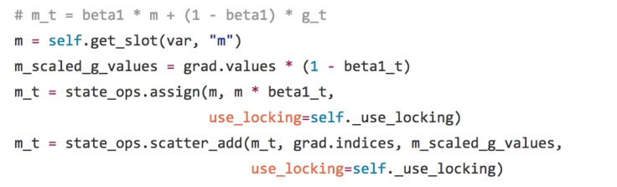
hardware
more...
package
Tensorflow
• A domain specific language (DSL) for Python
• A rich set of operators
• Rich features
• Codes are not very
easy to read
Implement Adam

Slide 37
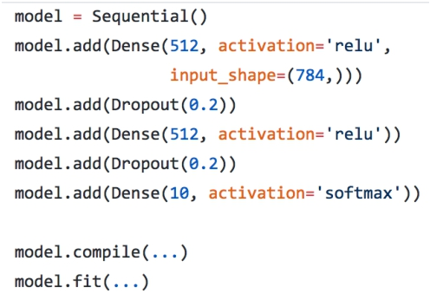
hardware
more...
package
Keras
• Simple DSL for Python, can use multiple backend (TensoFlow, MXNet, CNTK…)
• Easier to use than
TensorFlow
• May be slower
• Less convenient to
develop and debug

Slide 38
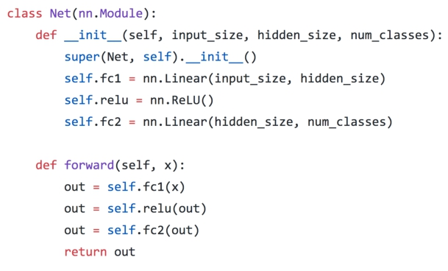
hardware
more...
package
Pytorch
• Torch tensors + chainer neural networks
• Easy to develop and
debug
• Less convenient to
deploy

Slide 39
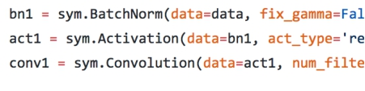
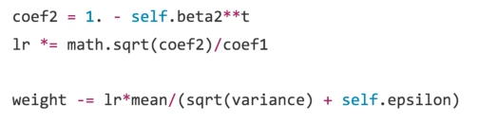
hardware
more...
package
MXNet
Implement Resnet
Implement Adam
• Numpy-like Tensor + Keras-like neural networks
• Performance
• Usability

Slide 40
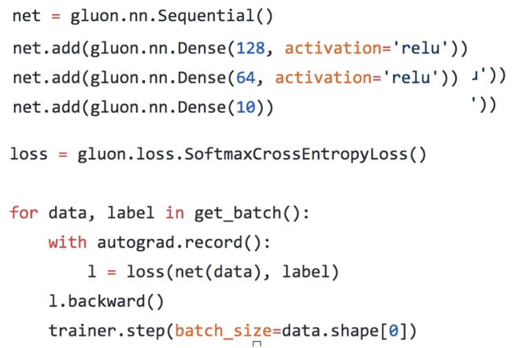
hardware
more...
package
MXNet + Gluon
• Numpy-like tensor + Chainer/pytorch-like neural network
• Easy to develop and
debug
• Performance

Slide 41
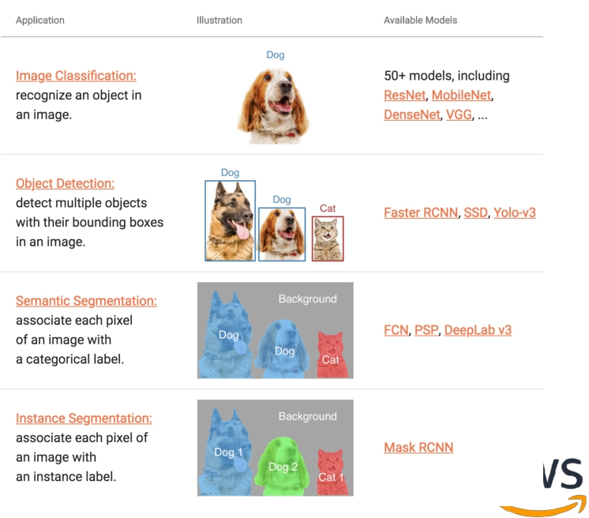
hardware
more...
package
GluonCV
• Toolkit for computer
vision
• https://gluon-
cv.mxnet.io/
• Pre-trained models
• Training scripts to reproduce SOTA results

Slide 42
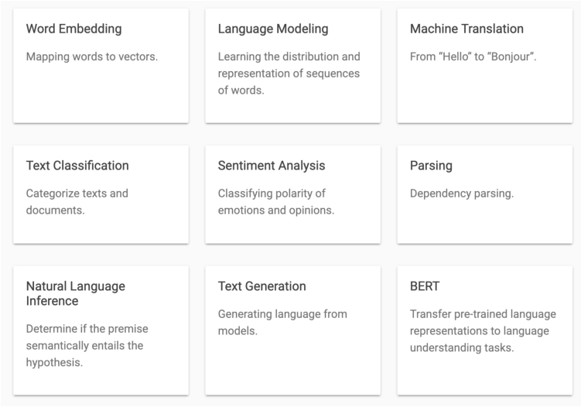
hardware
more...
package
GluonNLP
• Toolkit for NLP
• https://gluon-
nlp.mxnet.io/
• Pre-trained models
• Training scripts to reproduce SOTA results

Slide 43
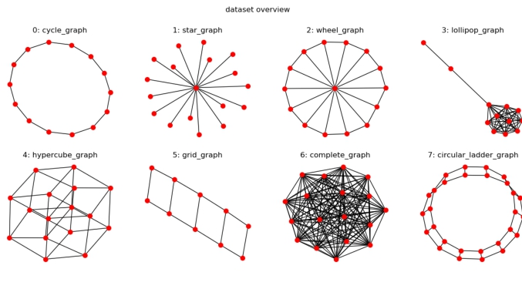
hardware
more...
package
DGL
• Toolkit for graph neural
networks
• https://www.dgl.ai/
• Relatively new, but with
good model coverage
• Has both MXNet and
PyTorch backend

Slide 44
hardware
more...
package
Roadmap for 2019
• More toolkits
• Time series, AutoML, …
• 100% numpy-compatible
• A new np package in mxnet
• Compiler integration
• 50% performance boost on CPU/GPU
• More hardware coverage: edge, ASIC, …

Slide 45
hardware
more...
package
G LUON

Slide 46
hardware
more...
package
Gluon - Imperative Neural Network API
• Create layers and neural networks
• gluon.nn
• Initialize and update parameters
• gluon.Parameter
• Use GPUs

Slide 47
hardware
more...
package
Summary
• Hardware for Deep Learning
• CPU
• GPU
• More Promising Hardware
• FPGA
• AI ASIC
• Packages
• Caffe, TensorFlow, Keras, PyTorch, MXNet, Gluon

Slide 48
Schedule
8:30-9:30 Lecture 1: Introduction
9:45-10:45 Lecture 2: Course Materials and Resources
11:00-12:00 Lecture 3: Perceptron
12:00-1:15 Lunch break
1:15-2:00 Lecture 4: Neural Network, Software
2:15-3:00 Lecture 5: Convolution Networks
3:15-4:00 Lecture 6: Some Examples
4:00 Adjourn

